Slide 1
Project presentation on :- MALIGNANT COMMENTS CLASSIFIER
Submitted by :
SANDEEP KUMAR

Slide 2
Table Of Contents :-
1. Introduction
1.1 Problem Statement and understanding
2. EDA steps and Visualization
3. Steps and assumptions used to complete the project
3.1 Data Preprocessing Done
3.2 Set of assumptions related to the problem under consideration
4. Model Dashboard
5. Finalized Model
6. Conclusion
7. Acknowledgement

Slide 3
INTRODUCTION
Problem statement and understanding
The proliferation of social media enables people to express their opinions widely online. However, at the same time, this has resulted in the emergence of conflict and hate, making online environments uninviting for users. Although researchers have found that hate is a problem across multiple platforms, there is a lack of models for online hate detection.
Our goal is to build a prototype of online hate and abuse comment classifier which can used to classify hate and offensive comments so that it can be controlled and restricted from spreading hatred and cyberbullying.

Slide 4
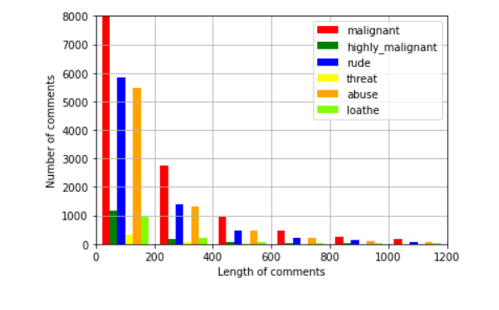
EDA steps and Visualization
Number of comments classified as malignant, highly malignant, rude, threat, abuse, loathe depending on the length.

Slide 5
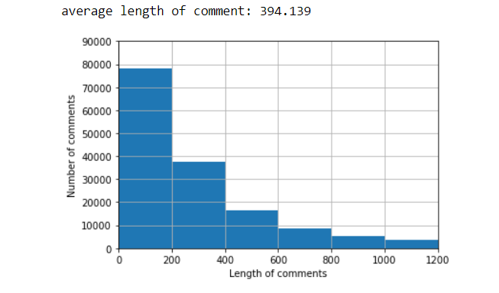
Number of comments having length varying from 0 to 1200.
Average length of comments is 394.139

Slide 6
Steps and assumptions used to complete the project
Data Preprocessing Done
It was observed that running train_test_split on the heavy preprocessed dataframe sometimes resulted in system going out of memory. Hence to avoid such cases, one extra line of code was added. The df.reindex code will shuffle the indices initially, so that later splitting dataset into training and testing will give fairer results.

Slide 7
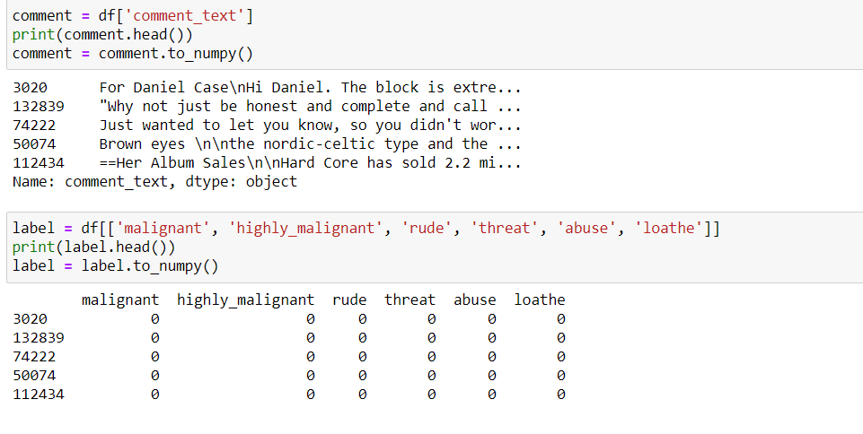
We then separated comment text data and outcome labels as shown below,

Slide 8
Preprocessing involved the following steps, but these were performed in a slightly different manner:
Removing Punctuations and other special characters
Splitting the comments into individual words
Removing Stop Words
Stemming and Lemmatising
Applying Hash Vectorizer
Splitting dataset into Training and Testing

Slide 9
Some very large length comments can be seen, in our dataset. These pose serious problems like adding excessively more words to the training dataset, causing training time to increase and accuracy to decrease! Hence, a threshold of 400 characters will be created and only comments which have length smaller than 400 will be used further.
Hence, after removing comments longer than 400 characters, we are still left with 115893 comments, which seems enough for training purposes.

Slide 10
Set of assumptions related to the problem under consideration
By looking into the target vaariable label we assumed that it was a Multiclass classification type of problem.
We assumed that running train_test_split on the heavy preprocessed dataframe sometimes results in system going out of memory. Hence to avoid such cases, one extra line of code was added. The df.reindex code shuffled the indices initially, so that later splitting dataset into training and testing will give fairer results.
We assumed that the id column was unique id to all the rows and we will be not needing it.

Slide 11
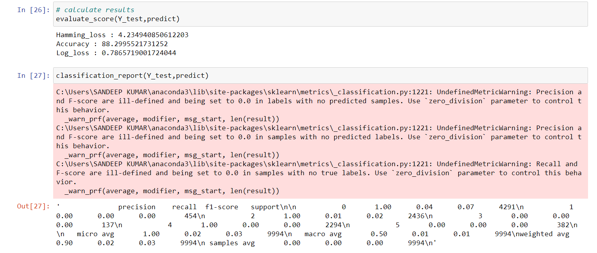
Model Dashboard​
Binary Relevance (BR) Method with MultinomialNB classifiers (from scratch) :-

Slide 12
BR method with Multinomial classifier from scikit multilearn:-

Slide 13
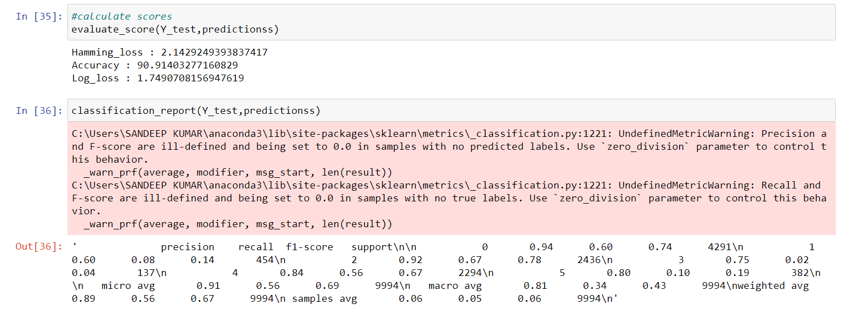
BR method with SVM classifier:-

Slide 14
Finalized Model
We used the metric log loss by selecting BR method with Multinomial classifier from scikit multilearn model which was giving us best(minimum) log loss score of 0.77.

Slide 15
Conclusion
This project proposed a Machine Learning Approach combined with Natural Language Processing for toxicity detection and its type identification in user comments. Finally, the best score of minimu log loss was achieved through BR method with multinomial classifier from scikit multilearn.

Slide 16
Acknowledgement
I would like to express my special thanks of grattitude to the sources Medium, TowardsDataScience, StackOverflow, KrishNaik’s youtube channel which helped me to accomplish this project.

